Slide 1
DigiZest 1.0
Smart Campus

Slide 2


Slide 3
Problem Statement
In an era of increasing digitalization and connectivity, university clubs and events play a pivotal role in enhancing the student experience. To ensure that students can easily discover, engage with, and participate in these activities, a mobile app has been developed. However, the app faces several challenges that hinder its effectiveness in serving both club organizers and students. The goal of this hackathon is to address these challenges, improve the app's functionality, and create innovative solutions that empower university clubs and enhance the overall student engagement experience.

Slide 4
Solution
We have chosen to address the challenge of building a SMART campus, and to achieve this goal, we are developing a unified platform. This platform will consolidate all club events and important notices, simplifying access for newcomers, visitors, and freshers. It aims to provide a centralized hub for information related to various events organized by clubs, including but not limited to hackathons, registrations, recruitments, and more. This approach ensures that anyone seeking information can easily access and stay informed about campus activities.

Slide 5
Technology Stacks
Flutter
Dart
Android Studio
DataBase : Mysql
PHP

Slide 6
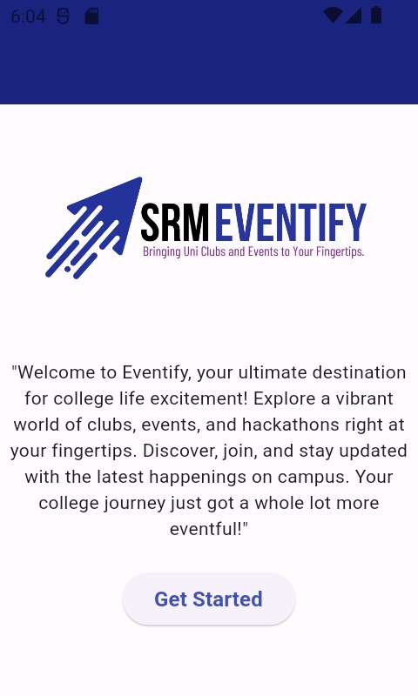
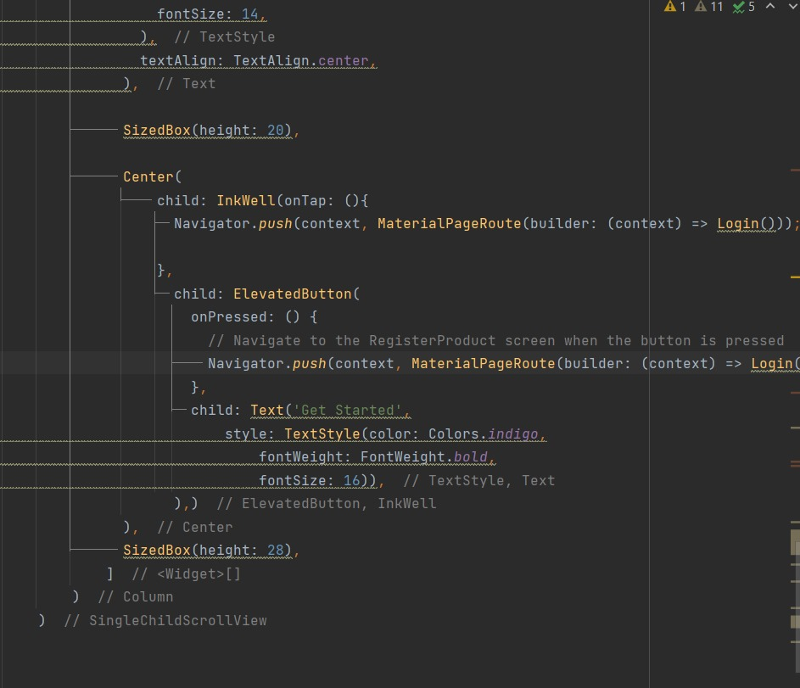

Slide 7
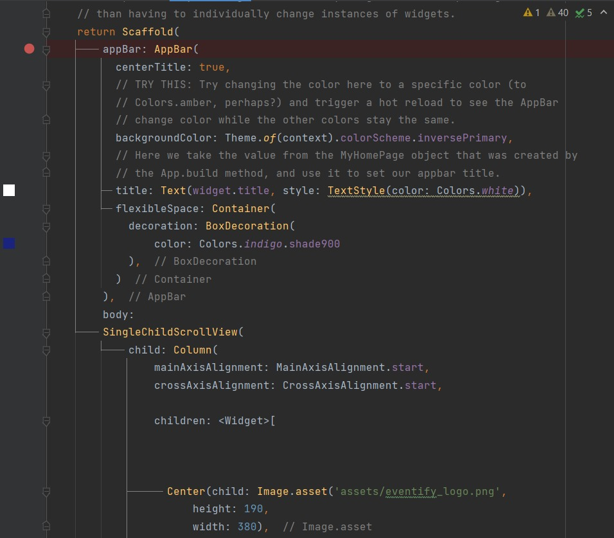
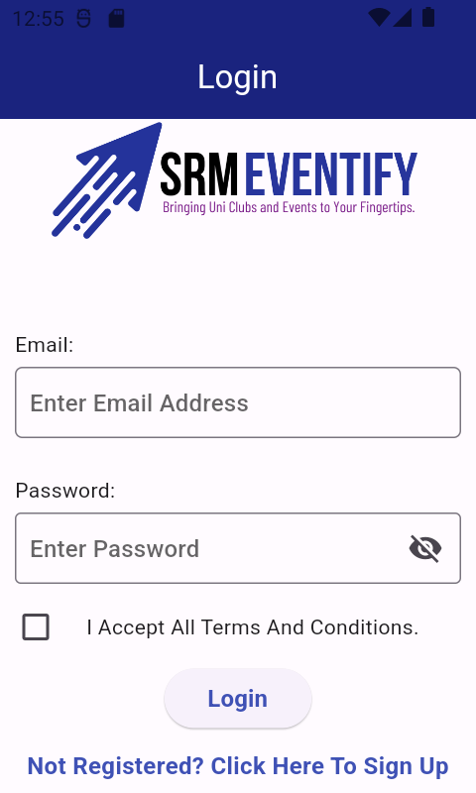
APP BAR

Slide 8
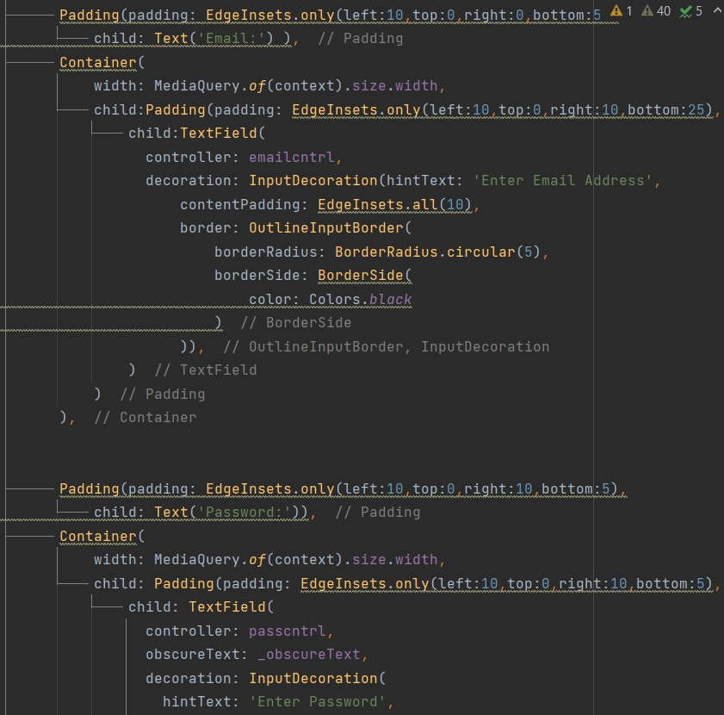
LOG IN PAGE

Slide 9
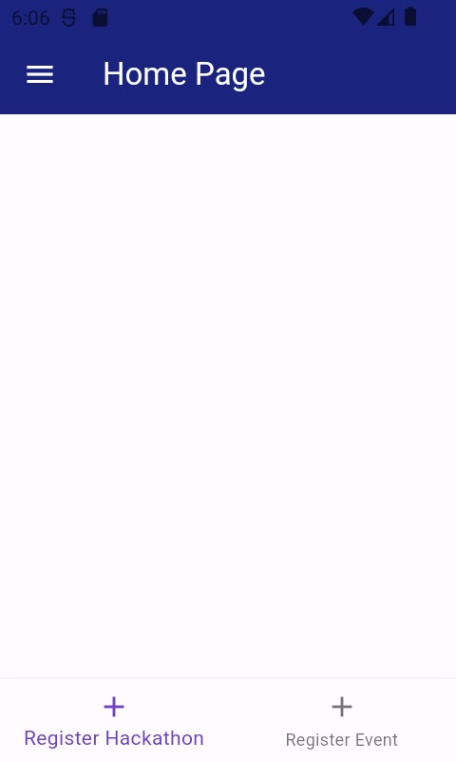
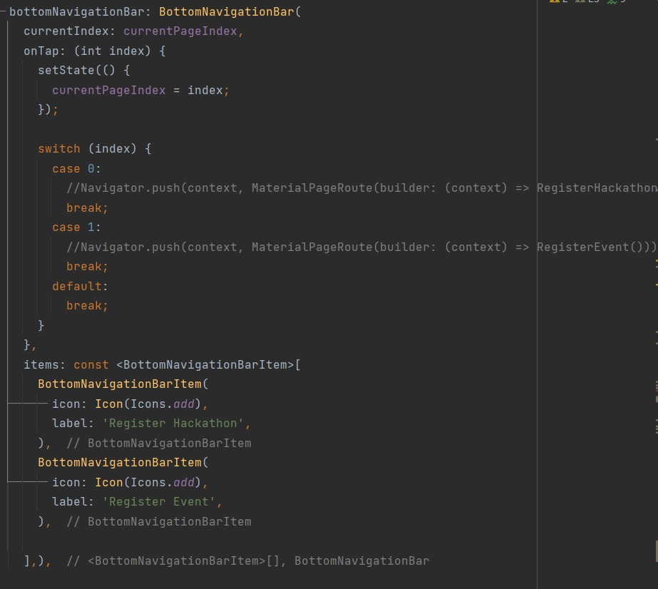

Slide 10
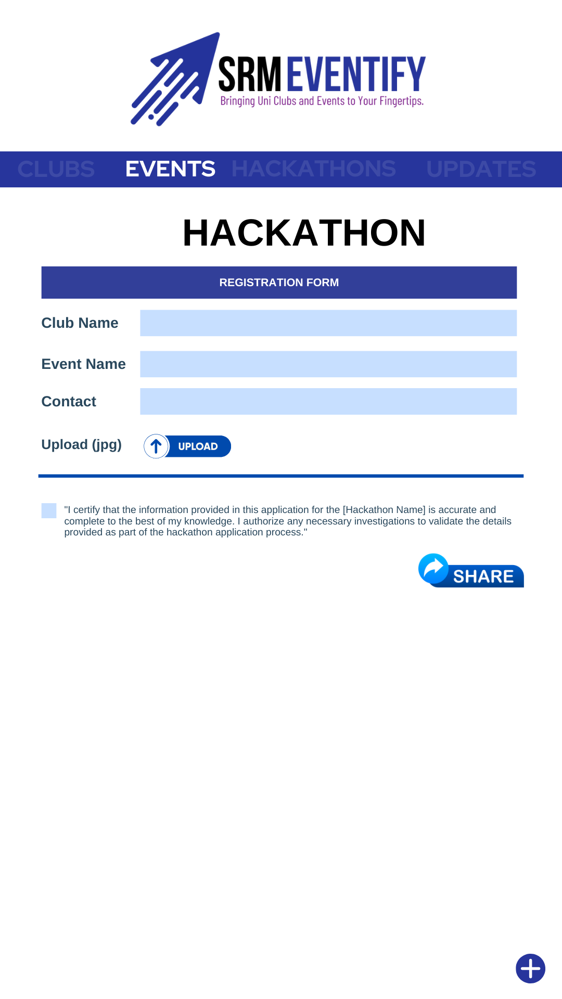
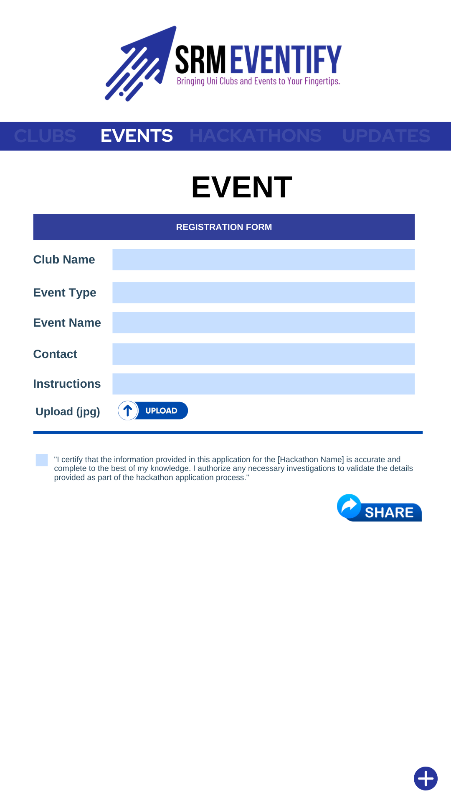
REGISTRATION FORM

Slide 11
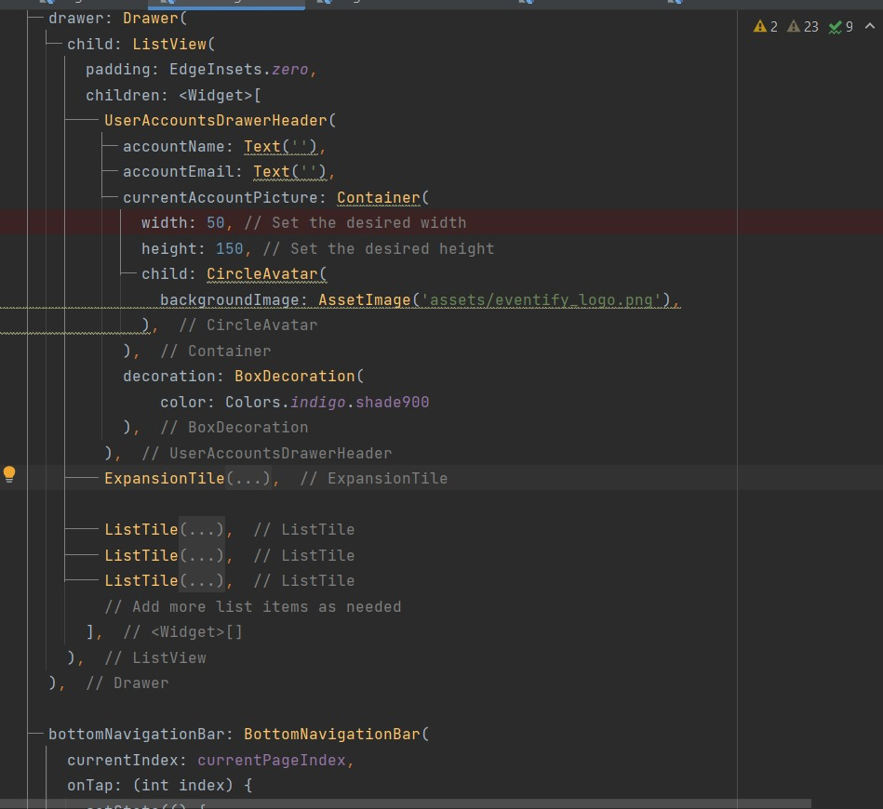
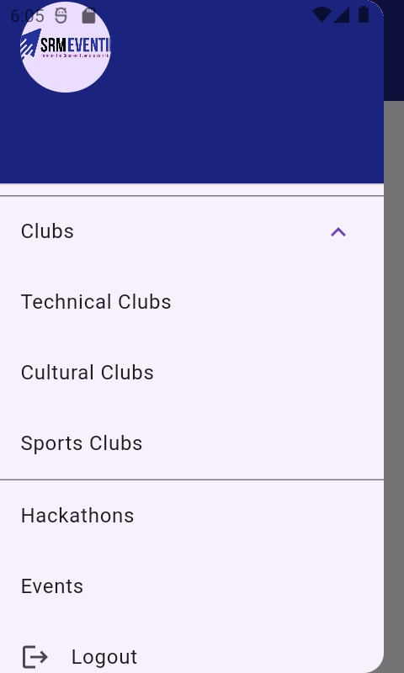

Slide 12
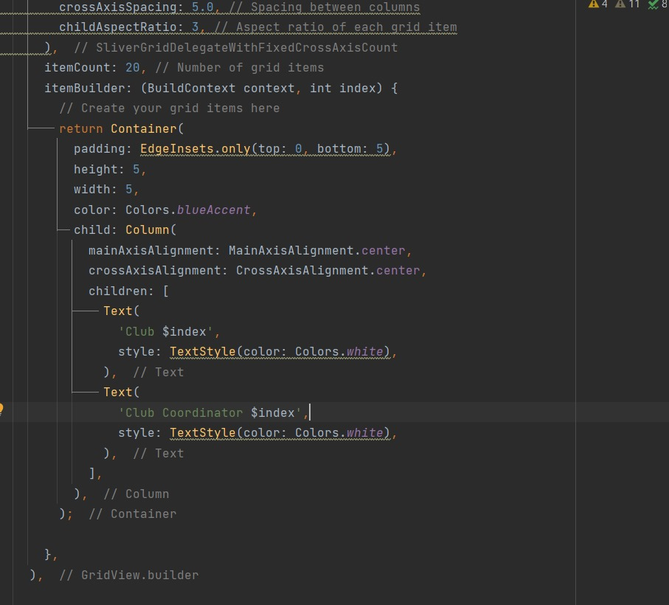
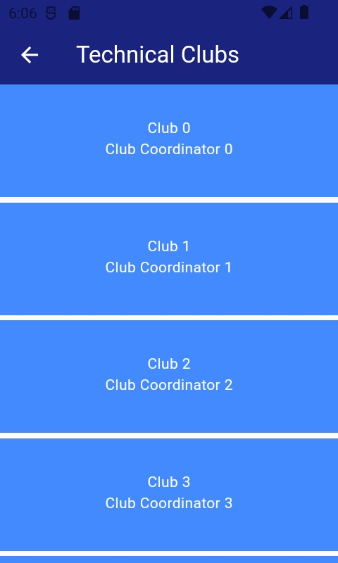
DRAWER

Slide 13
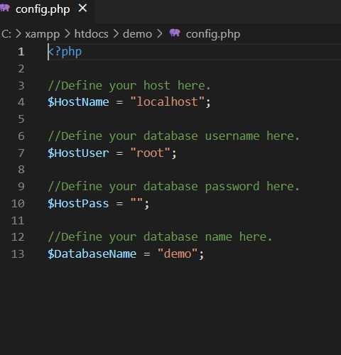
PHP FILES (BACK END)

Slide 14
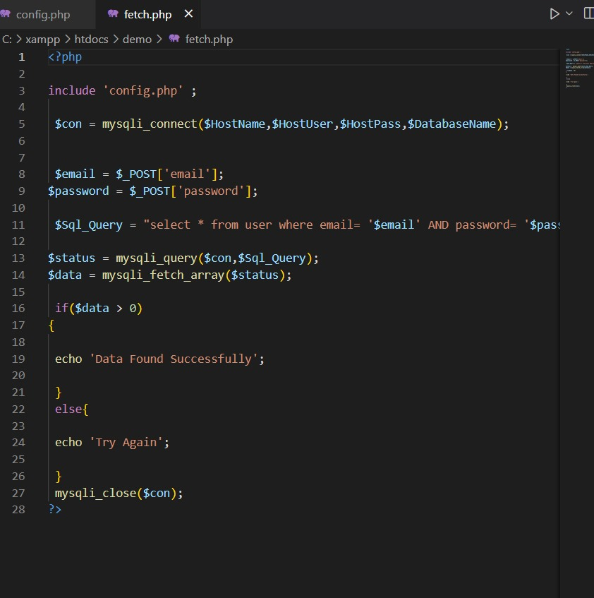
PHP FILES (BACK END)

Slide 15
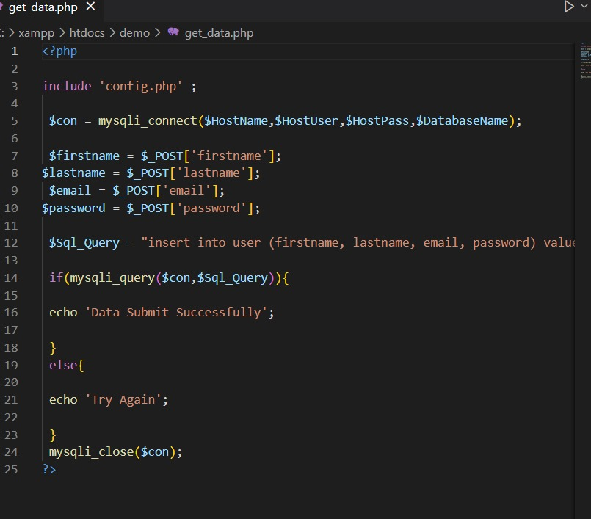
PHP FILES (BACK END)

Slide 16
THANK YOU
TEAM : FLASH CODERS

